Slide 1
Image classification project
We artificial intelligence training

Slide 2
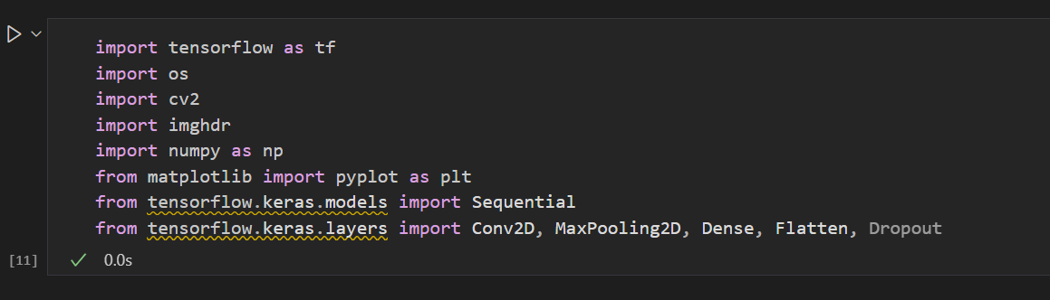
1 – import the libraries I need
First sept in project is importing to libraries like CV2,tensorflow and all libraries needed

Slide 3
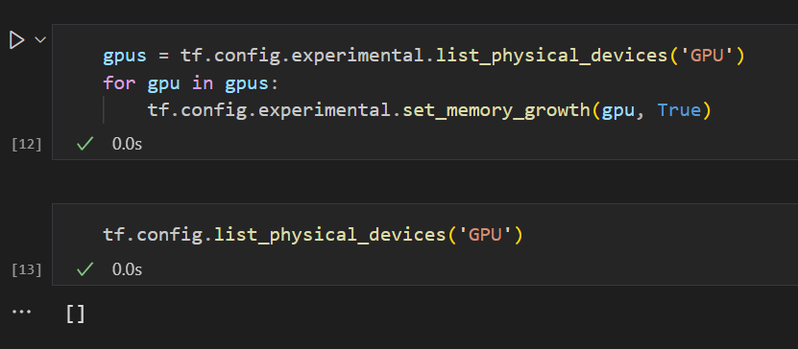
2-Make the computer process the code on the GPU
The graphics card is faster in processing images and video clips

Slide 4
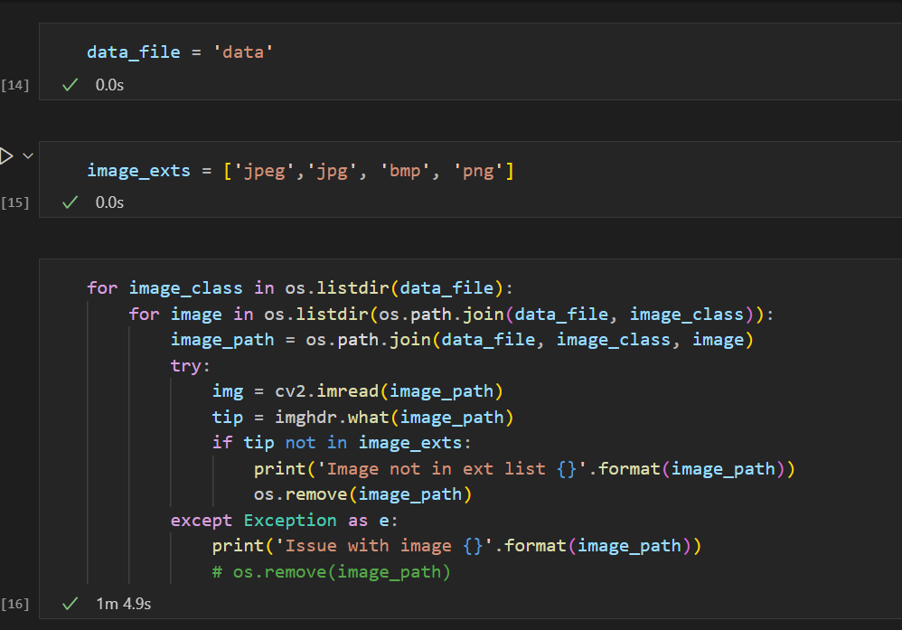
1 – delete image not exts
This code scans a group of image files in a specific folder and removes any image that is not with a supported extension
(Jpeg, Jpg, bmp and png)

Slide 5
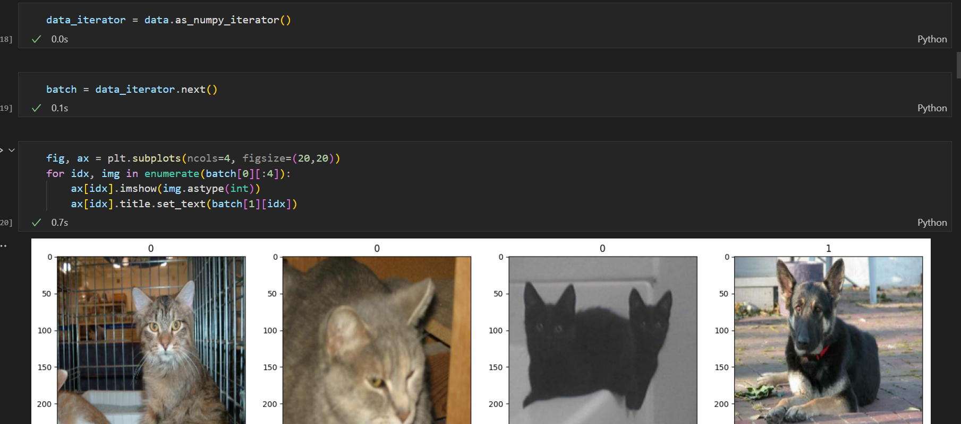
3-Load data

Slide 6
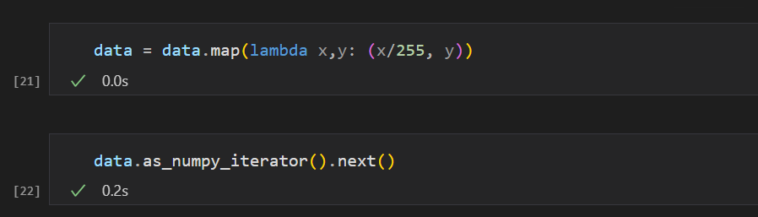
4 – Scale Data

Slide 7
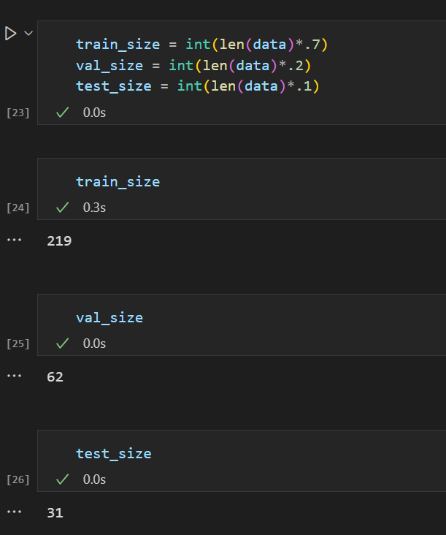
1 – Split Data
Split Data to train and val and test to train ML model and test this model
Traing size : 70%
Val size : 20%
Test size is 10 %

Slide 8
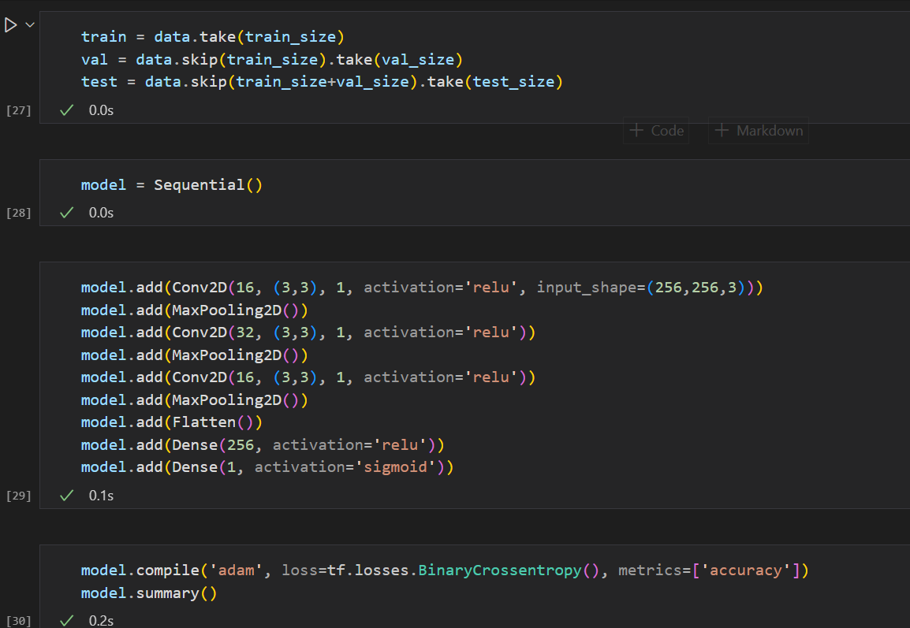
1 – Build Deep Learning Model
Build deep learning model with TensorFlow and set filters

Slide 9
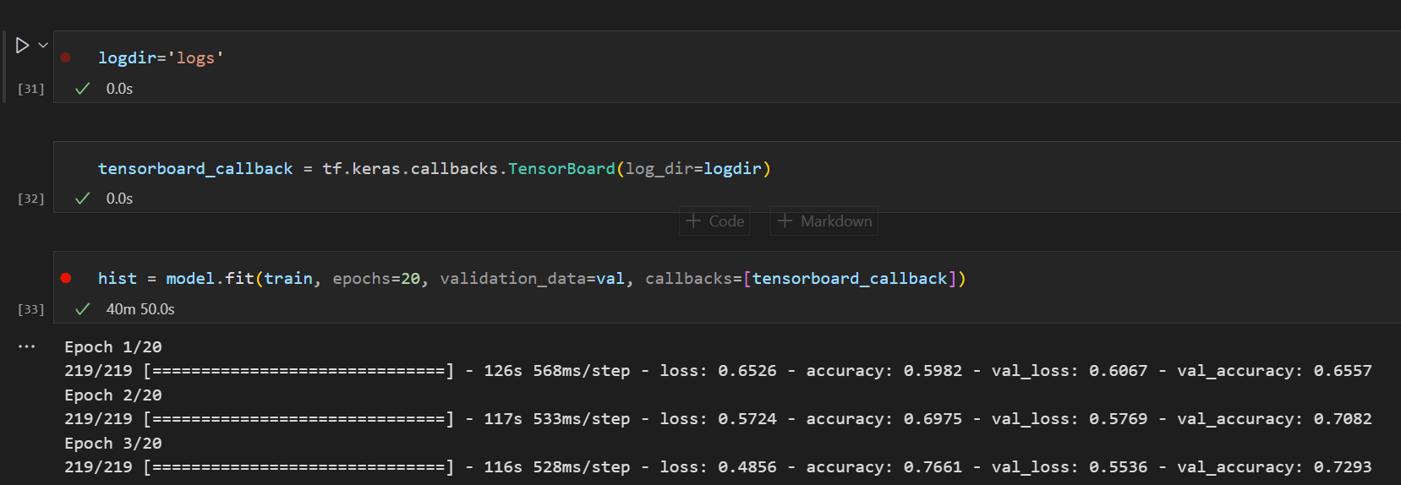
1 – Train the model
Train deep learning model with taring data by 20 epoch to get best accuracy and minimal loss value

Slide 10
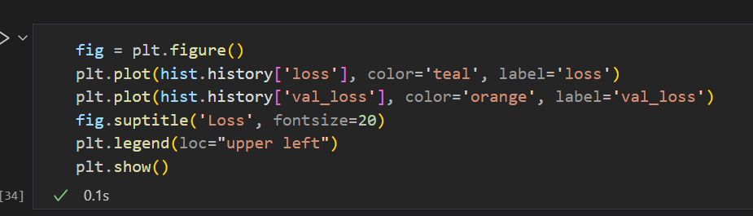
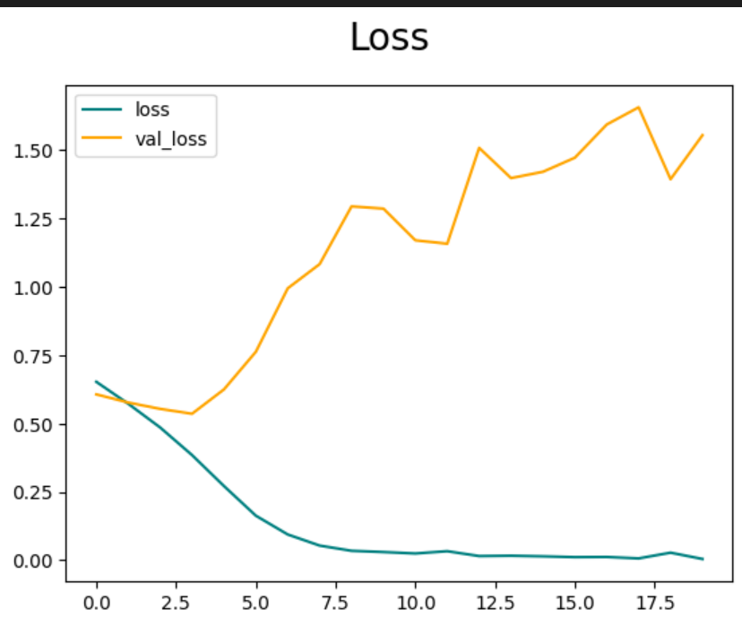
Fig NO.1
Figer to show Change in Performance of loss function from worst to best value

Slide 11
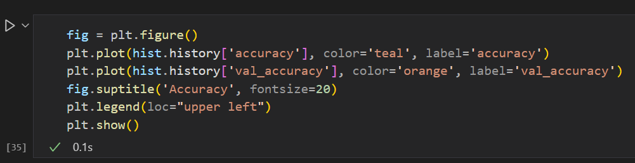
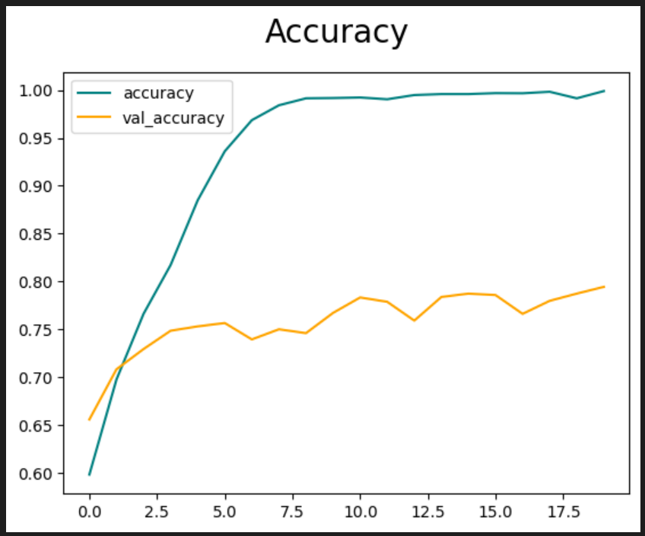
Fig NO.2
Figer to show Change in Performance of accuracy and accuracy for this model after taring is almost 1

Slide 12
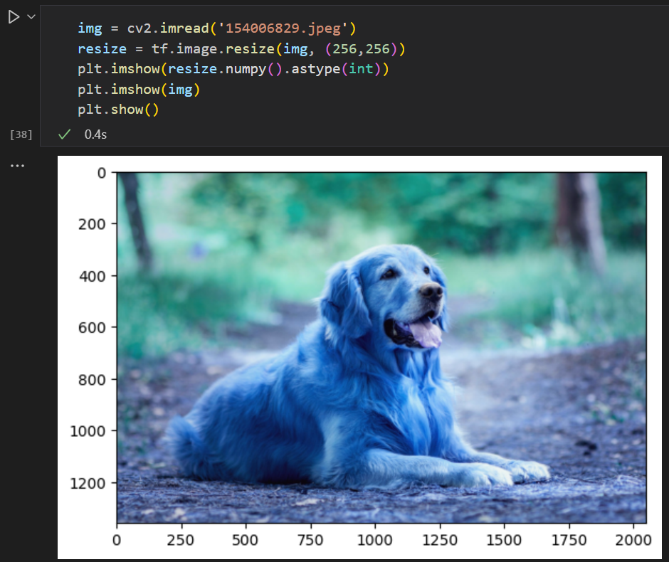
1 – import the libraries I need
First sept in project is importing to libraries like CV2,tensorflow and all libraries needed
Test case 1

Slide 13
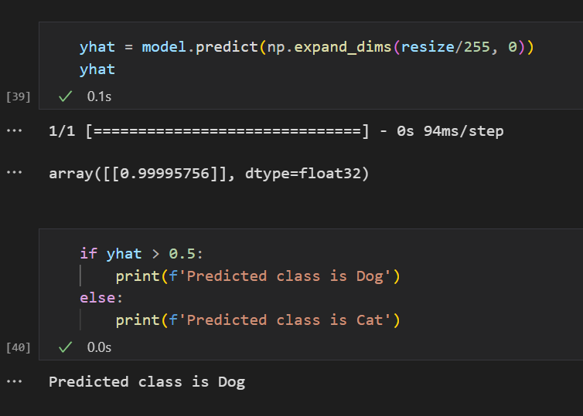
Test case 1 .result

Slide 14
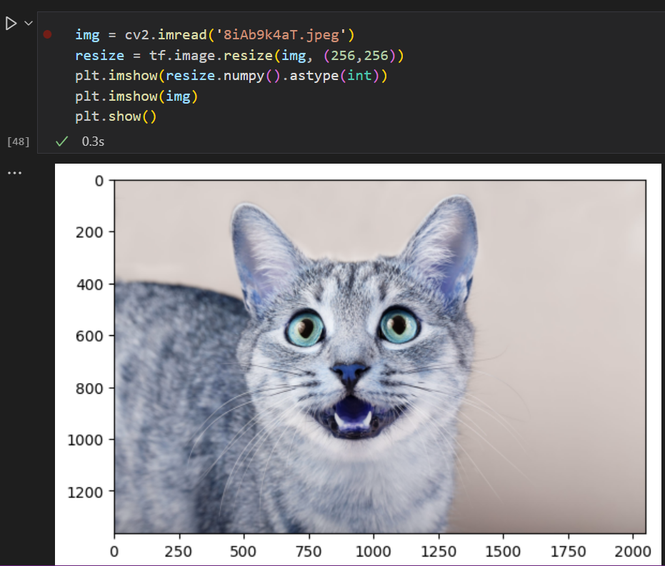
1 – import the libraries I need
First sept in project is importing to libraries like CV2,tensorflow and all libraries needed
Test case 2

Slide 15
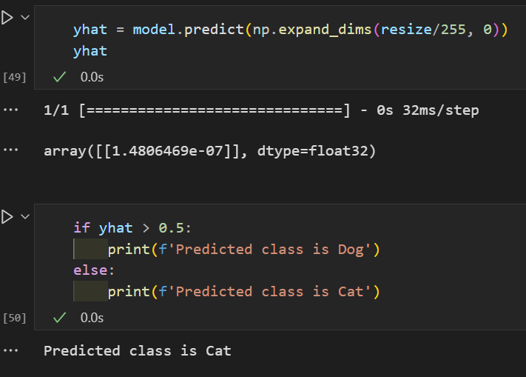
Test case 2 .result

